Slide 1
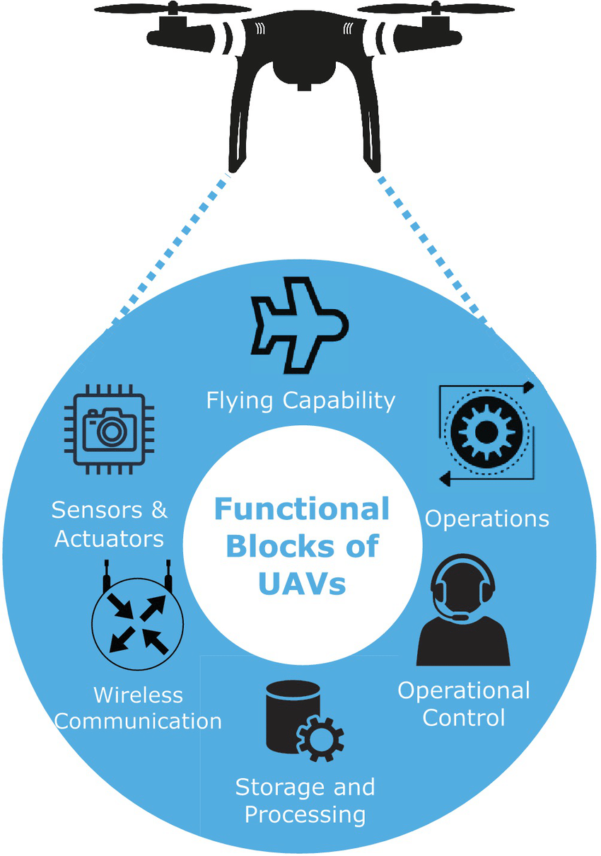
What is Drone?
How does it work?
Notes:
The basic functional blocks of the UAV comprise flying capability, equipped with sensors, storage, and processing capabilities,
wirelessly controlled by the control stations to perform task specific operations

Slide 2
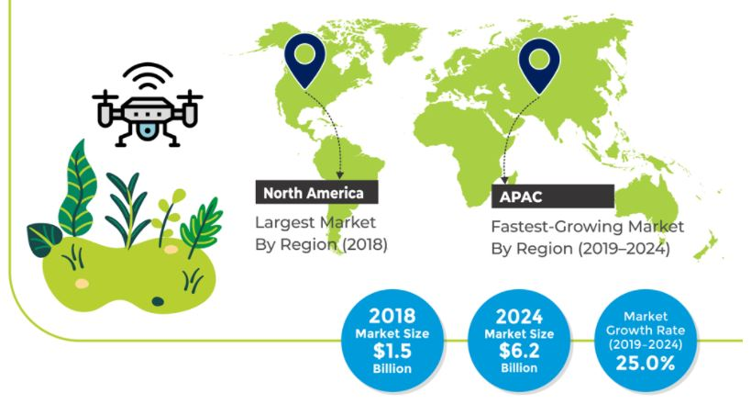
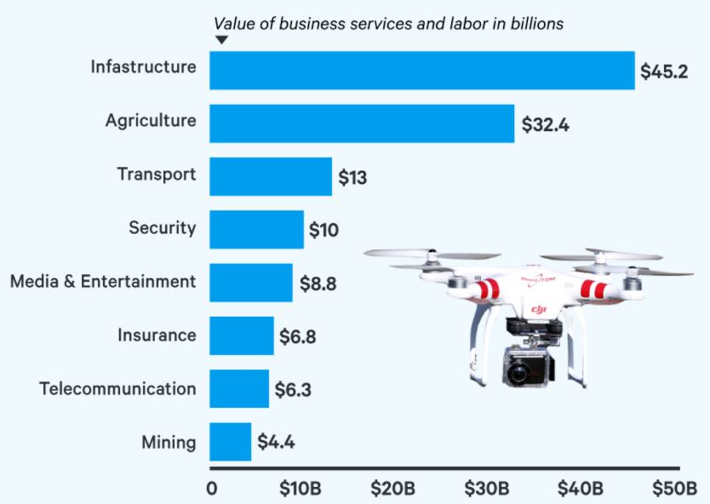
Market Growth & Trend of Drone
Global Agricultural Drones Market
Predicted Value of Drones by Industry 2020
(https://www.psmarketresearch.com/market-analysis/agricultural-drones-market)
(https://www.businessinsider.com/commercial-uav-market-analysis)

Slide 3


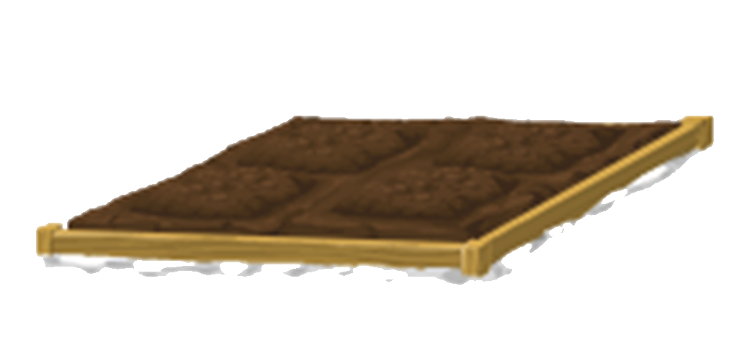
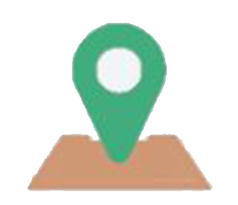



Crop Spraying
Irrigation
Soil & Field Analysis
Geofencing
Crop Monitoring
Crop Insurance
Planting
Applications of Drones in Agriculture
Applications of Drones in Agriculture

Slide 4

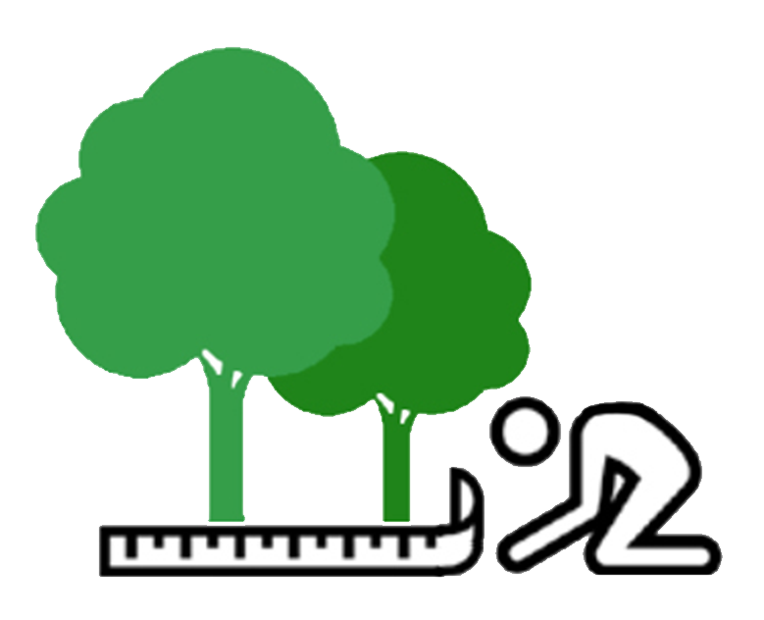

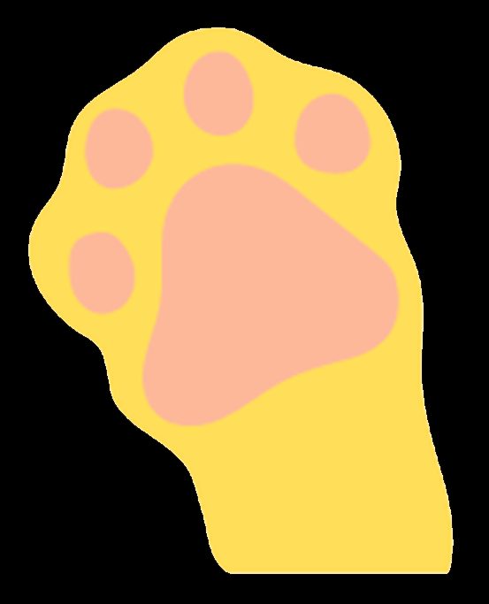

Mapping Forests and Biodiversity
Mapping Canopy Gaps & Height
Tree Disease Detection
Wildlife Monitoring
Forest Fire Fighting
Applications of Drones in Forestry
Applications of Drones in Forestry

Slide 5



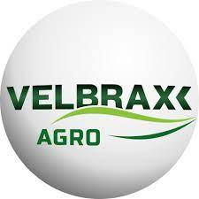

Drone Startups in Malaysia / Brazil / Indonesia
Startup | Country | Application of Drone
Aerodyne (Agrimor SuperApp) | Malaysia | Topped the list of top global drone service providers in 2021 Known as a DT3 (drone technology, data technology and digital transformation) enterprise solution provider with service such as agriculture seeding and spraying
Braintree Technologies | Malaysia | In line with PETRONAS Sustainability Agenda and the United Nations’ Sustainable Development Goals (SDGs) 8, 9 and 13 which focus on promoting sustainability of economic growth with drone services such as plantation mapping.
Poladrone | Malaysia | Raised a largest seed round in Malaysia containing total of $4.29 in 2021 to revolutionize the way farms use pesticides through the combination of drones and automation and analytics software.
Velbrax | Brazil | Specializes in providing agricultural monitoring services such as weed detection and plantation failure detection.
Avirtech | Indonesia | Awarded Global Testbed Incentives (GTI) from Malaysia Digital Economy Corporation (MDEC) in March 2022 for their contribution to Malaysia agriculture sector through usage of drones for agriculture inspection and survey.
(https://www2.deloitte.com/my/en/pages/risk/articles/emerging-tech-innovation-in-malaysia-agriculture.html)

Slide 6



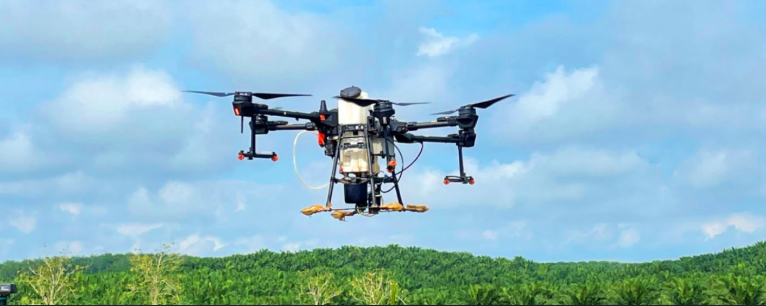
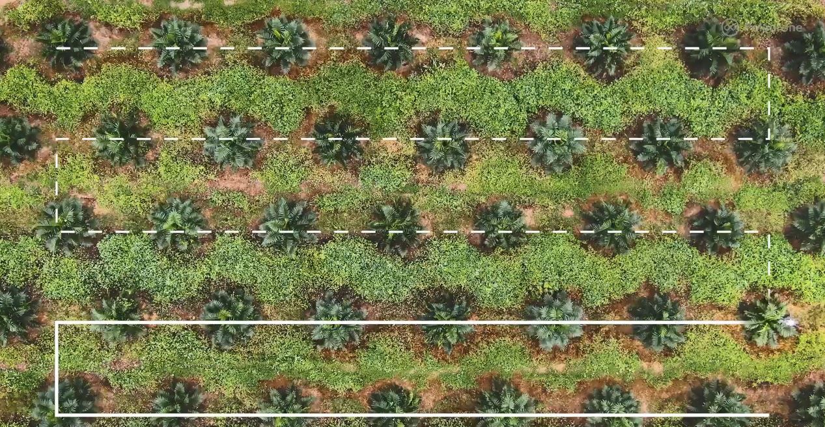
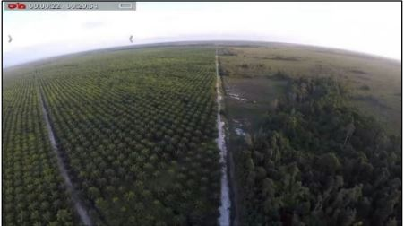
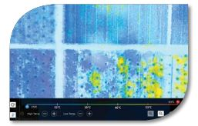
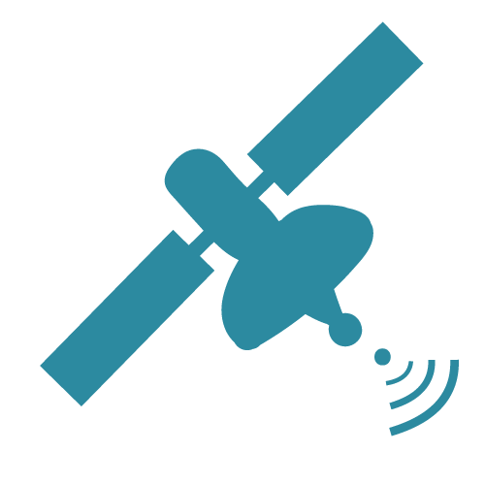
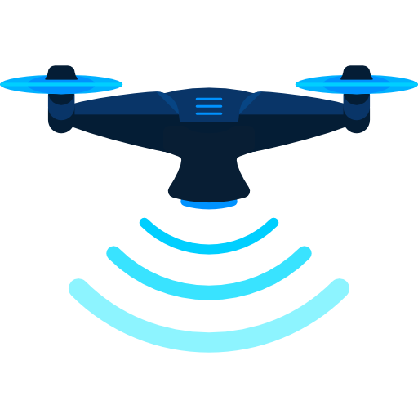
Drone Application By Palm Oil Producer in Malaysia
Sime Darby
IOI Group
Golden Agri-Resources
Pest Control
Firefighting
Deforestation Monitoring
Use of drone PTP (Point-to-Point) for precise spraying
Use of thermal imaging for fire detection
Combine satellite and drone for efficiency in monitoring forest
Notes:
Sime - Use of PTP for precise spraying
IOI - Monitoring with Drone equipped with 4K sensor & FLIR Lepton thermal micro camera
GAR - Satellite for change alerts while drone for aerial imaging

Slide 7
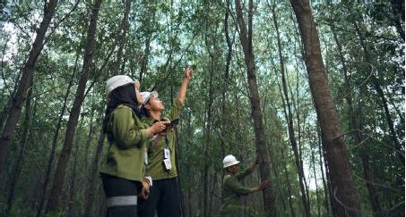
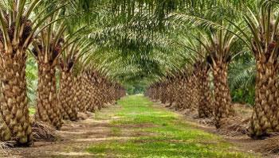
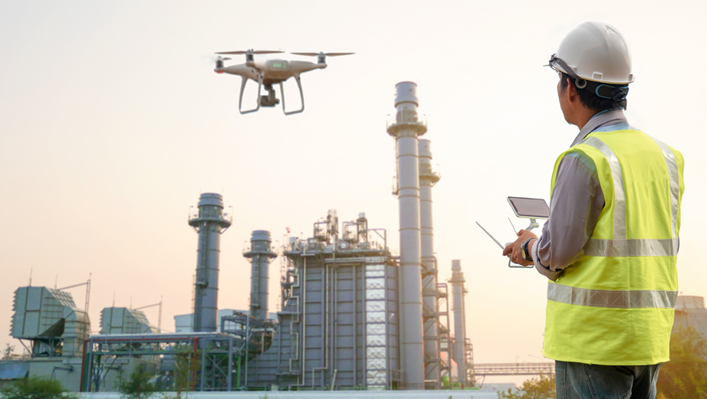
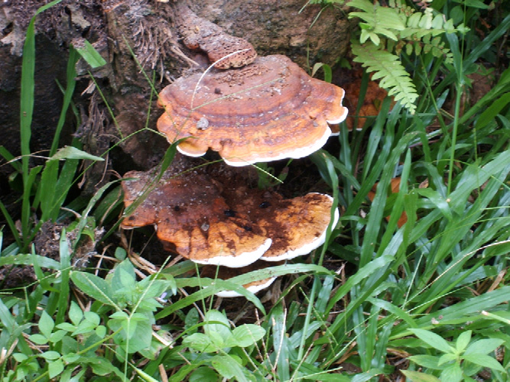
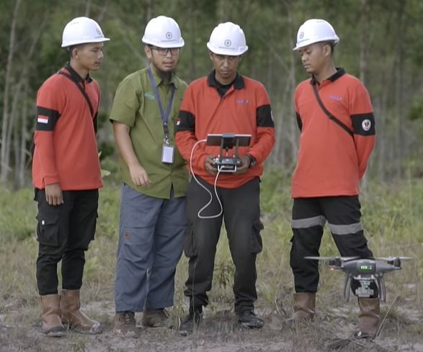
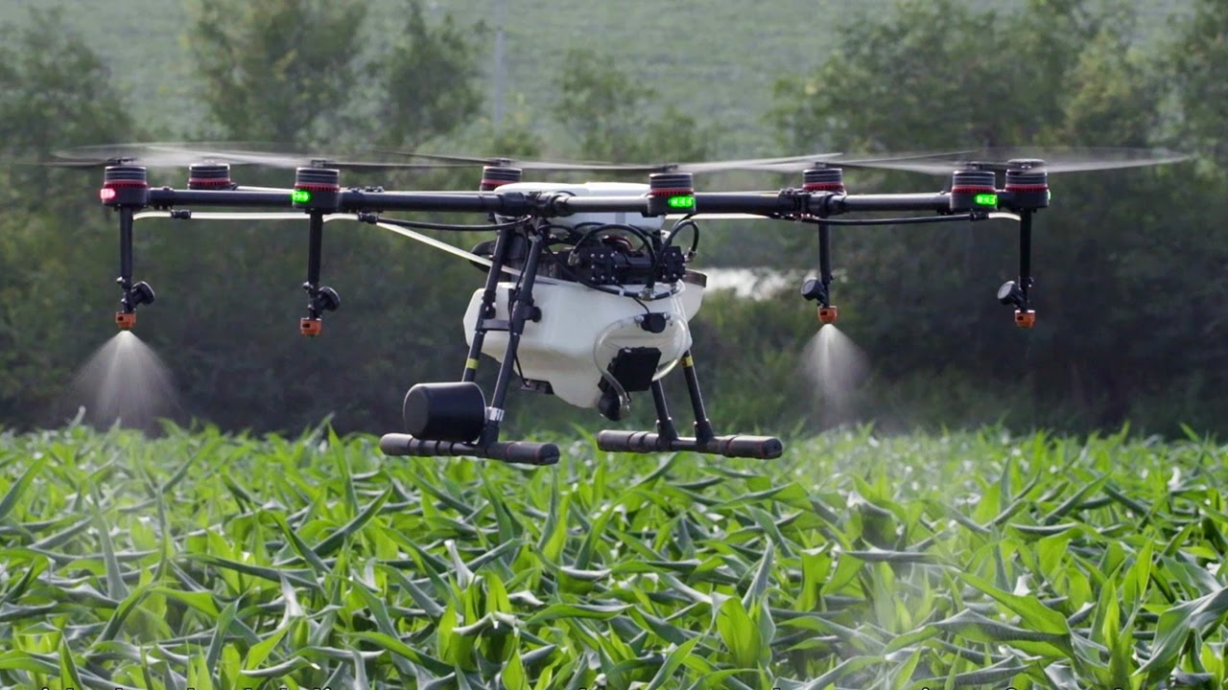
Plantation Monitoring in APRIL
Tree and Blank Spot Detection in AsianAgri
Mill Inspection in APRIL
Application of Drone in RGE
Plant Disease Detection in AsianAgri
Forest Firefighting in APRIL
Insecticide Spraying in APRIL

Slide 8
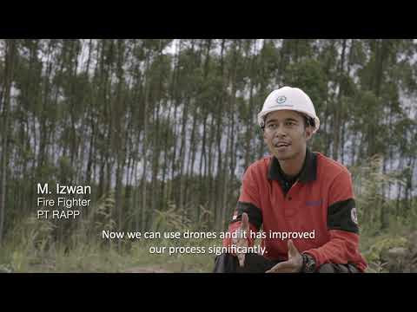
Application of Drone in RGE (Cont.)
How Drones Help Manage and Monitor Forests

Slide 9
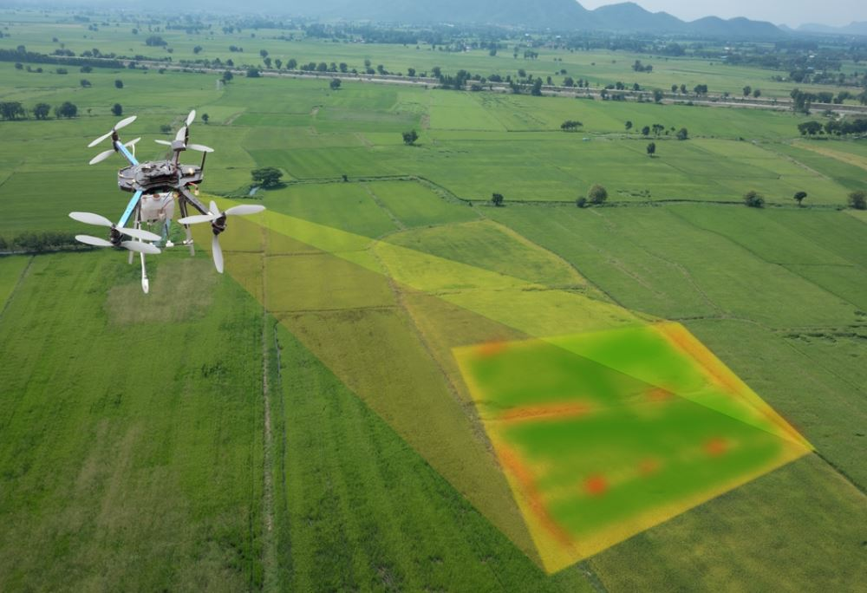
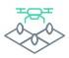




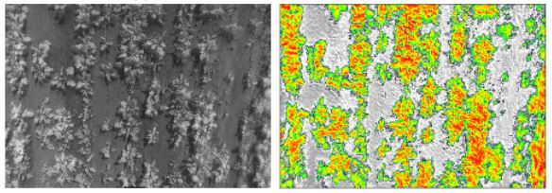
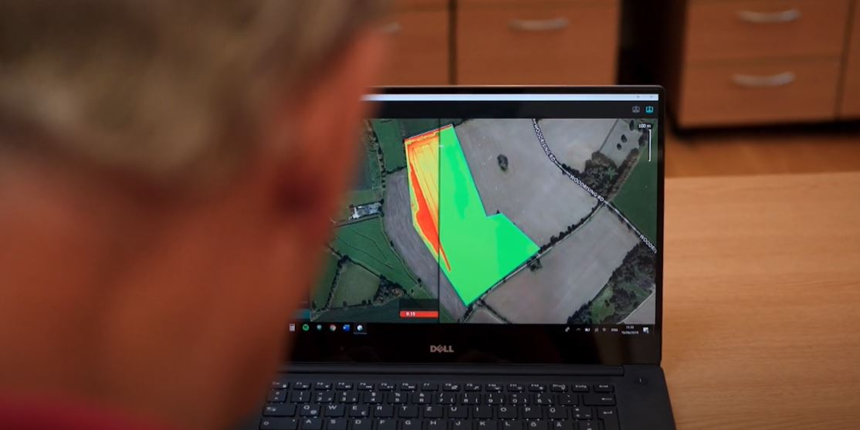
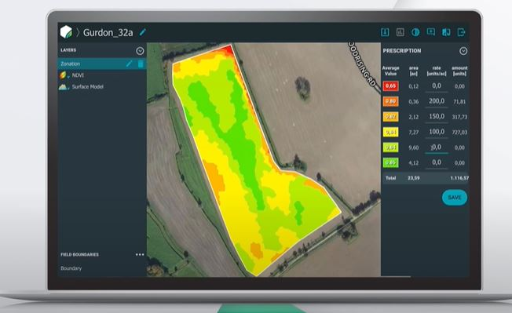
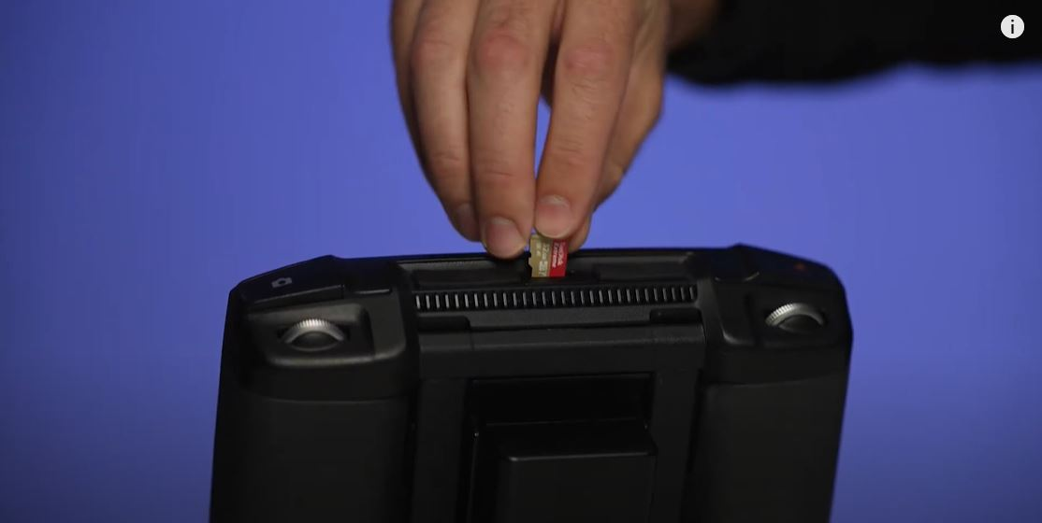
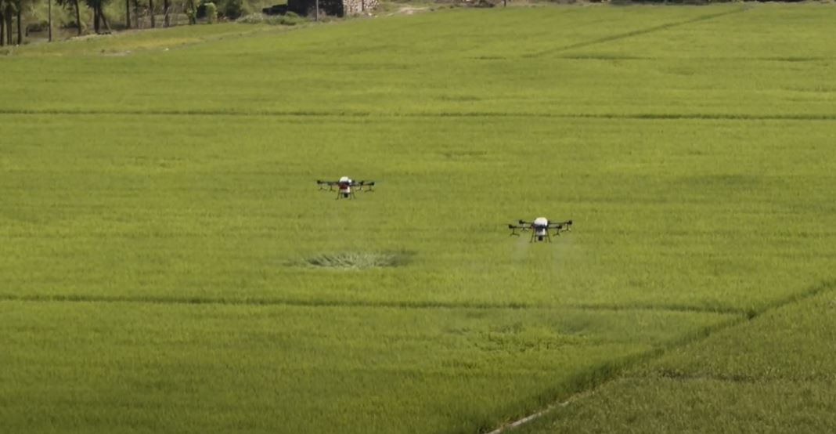
Use Case (Plant Monitoring)
Monitor
the fields
Collect
the images
Analysis
the images
Transfer
results to the integrated tools
Take
appropriate actions
NDVI (right) is extracted from an
input crop image (left)
Generate index map through post-processing software
Turn index map into zones
to be used for drones
Transfer designated zone
to the drone
Drone carry out action

Slide 10
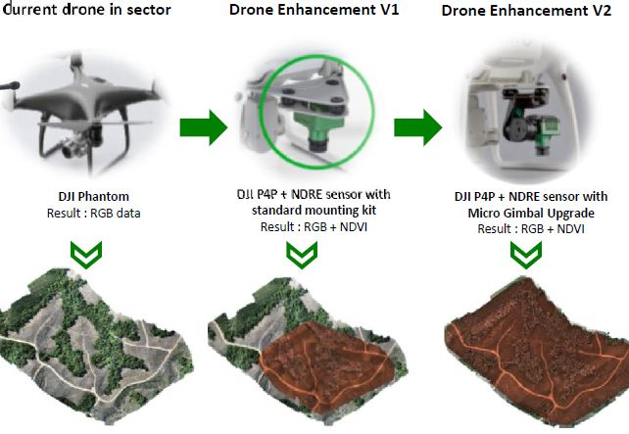
Use Case (Plant Monitoring) (Cont.)
Drone Sensor Improvement

Slide 11
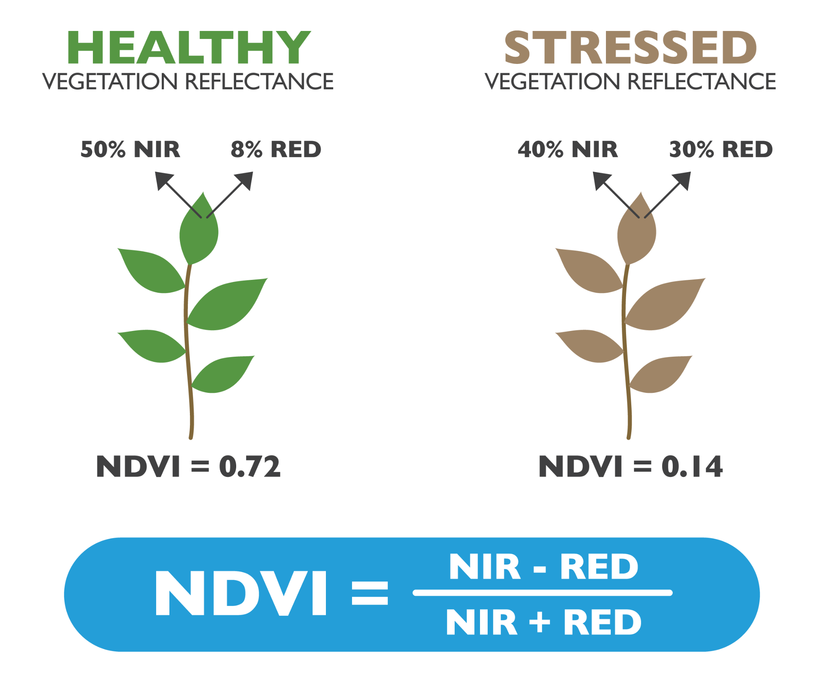
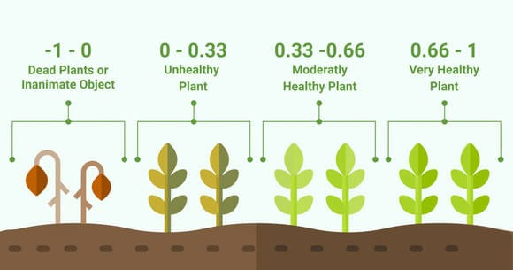
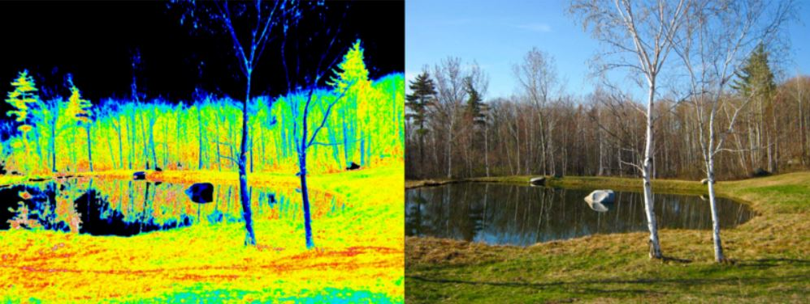
Use Case (Plant Monitoring) (Cont.)
How Drone Differentiate Plant Stress with NDVI
How NDVI is
measured
How NDVI is
displayed
Notes:
NDVI measures plant health based on how the plant reflects lights at near-infrared (NIR) and visible spectrum.
NDVI is computed as the ratio of the NIR and the Red channel
NDVI image was derived from two color channels in a single photo taken with a camera modified with a special infrared filter.
Red/orange/yellow indicates bare soil or dead vegetation while green means normal vegetations.

Slide 12
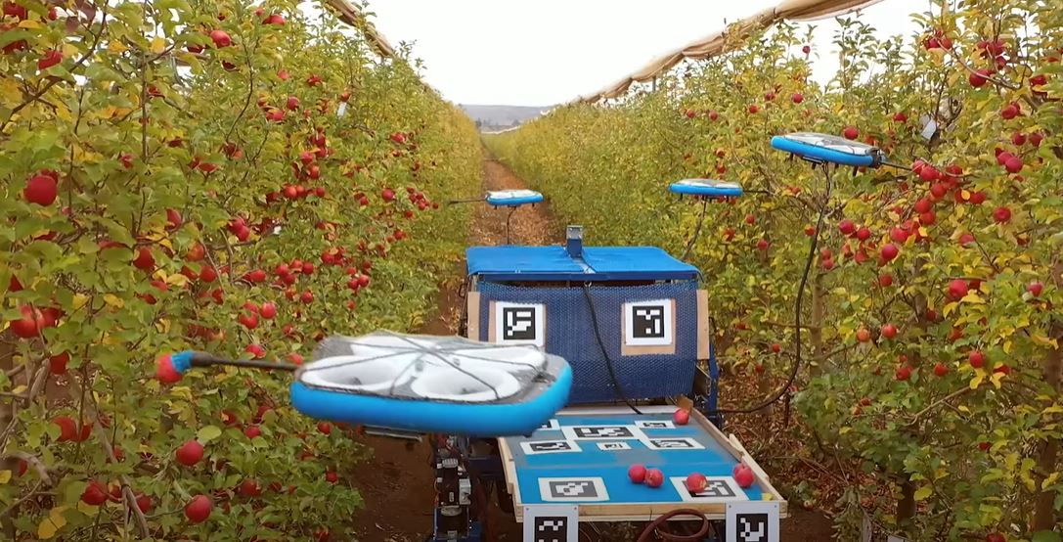
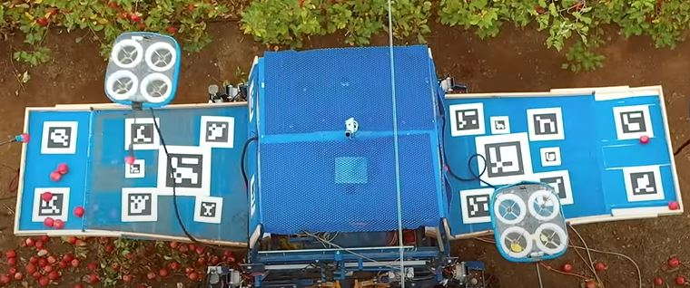
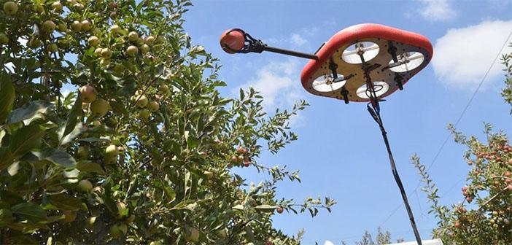
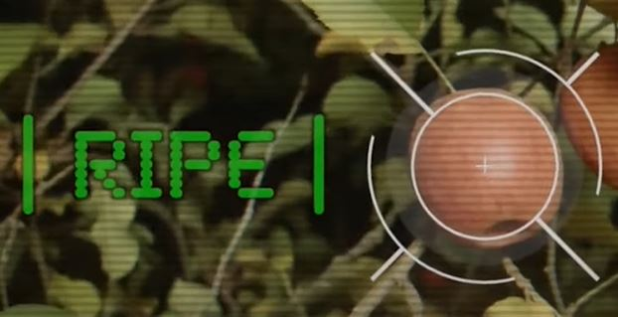
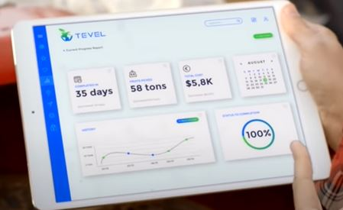
Use Case (Fruit-Picking)
Flying Autonomous Robots (FAR)
Tethered to a base station which does not require human work
Equipped with a grabber and forward-facing camera
Uses AI perception algorithms to detect food ripeness
Connected to cloud-based
interface

Slide 13
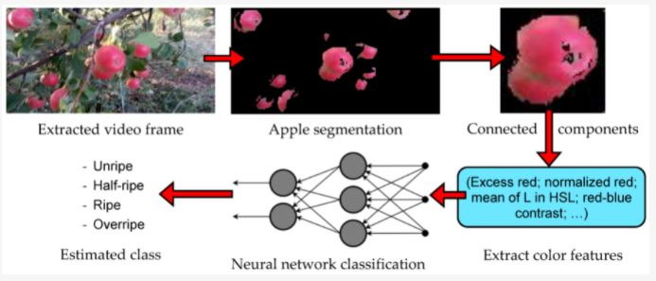
Use Case (Fruit-Picking) (Cont.)
Fruit Ripeness Detection Algorithm

Slide 14
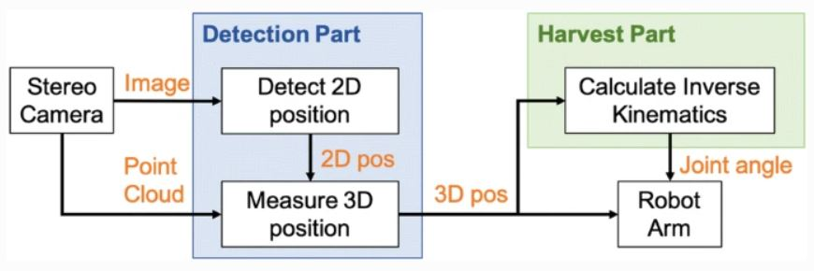
Use Case (Fruit-Picking) (Cont.)
Fruit Harvest Algorithm
Notes:
The drone transfer the image in real-time to a ground control and monitoring station via SSH or other connection.
The image will then be sent to an object detection & recognition algorithm.
The result will then be sent and transformed in a user interface.

Slide 15
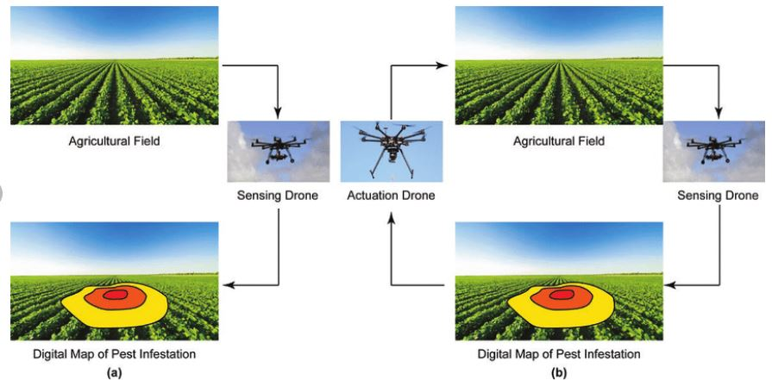
Use Case (Crop Spraying)
(Iost Filho, Fernando H., et al. "Drones: innovative technology for use in precision pest management." Journal of economic entomology 113.1 (2020): 1-25)
Notes:
Sensing drones could be used for detection of pest hotspots, while actuation drones could be used for precision distribution of solutions.

Slide 16
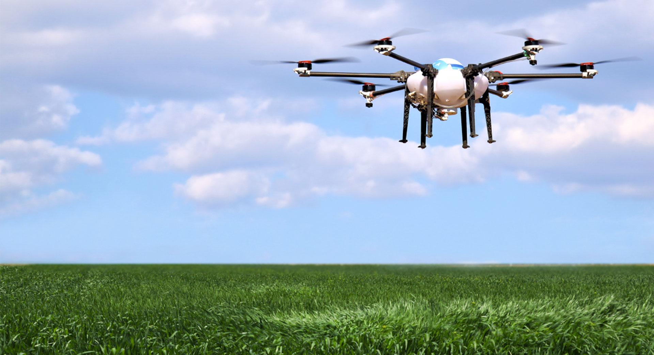
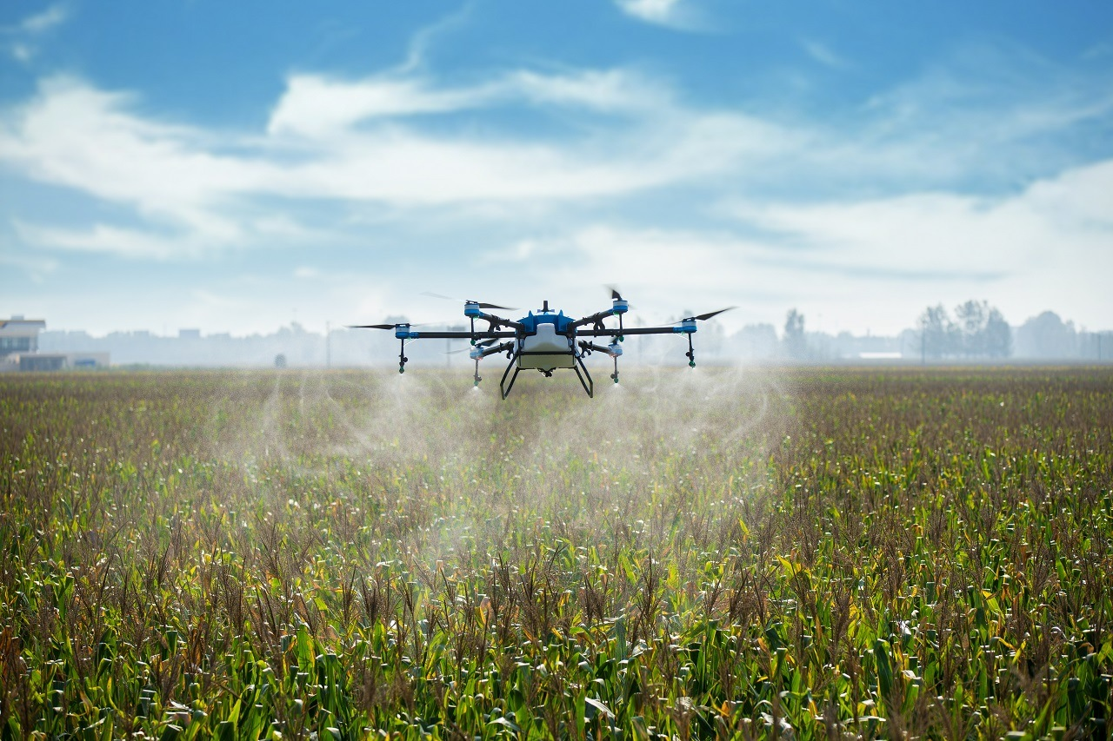
Use Case (Crop Spraying) (Cont.)
Farm Embedded System
Pest Detect Algorithm
Pest’s Generation
Pest’s Position
Sensing Drone
Farm Mapping
(Collect Pest Data)
Spraying Path Algorithm
Spraying Position
Actuation Drone
Spraying Sequence
Spraying Pesticides
Notes:
Pest images captured by the sensing drone are sent to the farm embedded system via the network.
Pest’s life stages and locations are detected in real-time.
The 3D flight path for the actuation drone are calculated based on each tree’s height on the slope and the pest’s position.
The flight sequence and path are then transmitted to the agricultural drone for spraying operation.

Slide 17
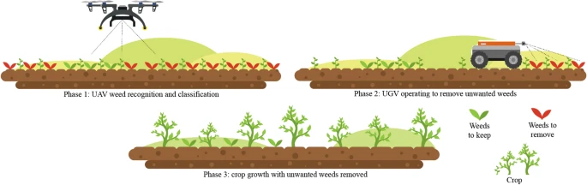
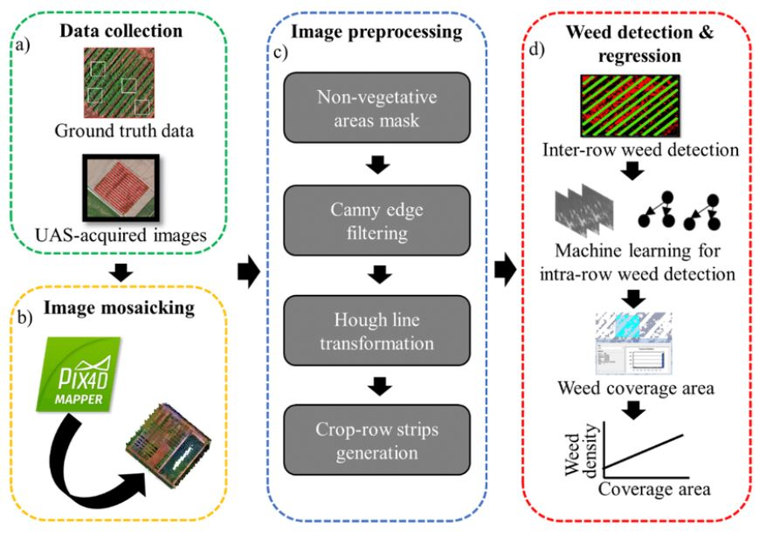
Use Case (Weed Detection)
Notes:
Step 1 - Image collect through drone
Step 2 - Drone images are mosaicked using Pix4D software
Step 3 - Image preprocessing for further analysis
Step 4 - Weed area is detected

Slide 18
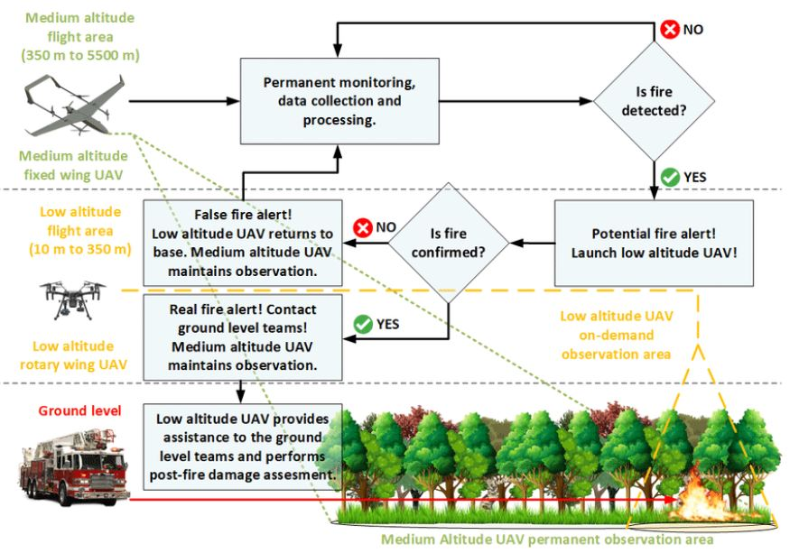
Use Case (Fire Detection)
(IHristov, Georgi, et al. "Emerging methods for early detection of forest fires using unmanned aerial vehicles and lorawan sensor networks." 2018 28th EAEEIE Annual Conference (EAEEIE). IEEE, 2018.)

Slide 19
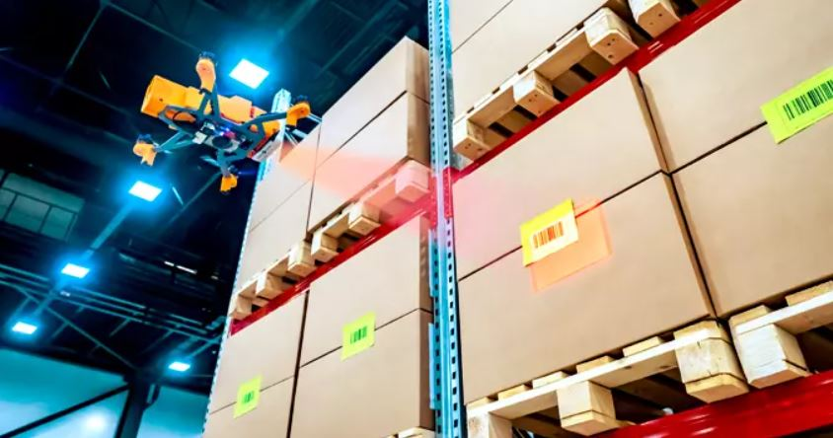
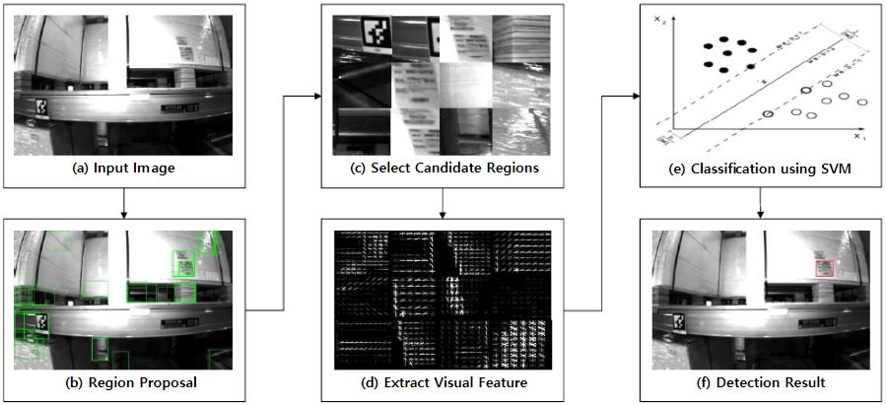
Use Case (Warehouse Barcode Scanning)
Notes:
Step 1 - Select the best region candidates using a selective search method.
Step 2 - Extract the salient features from the candidates.
Step 3 - The classification result is determined by a linear SVM for a fast calculation.

Slide 20
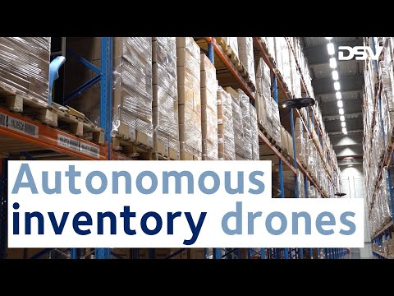
Use Case (Warehouse Barcode Scanning) (Cont.)

Slide 21
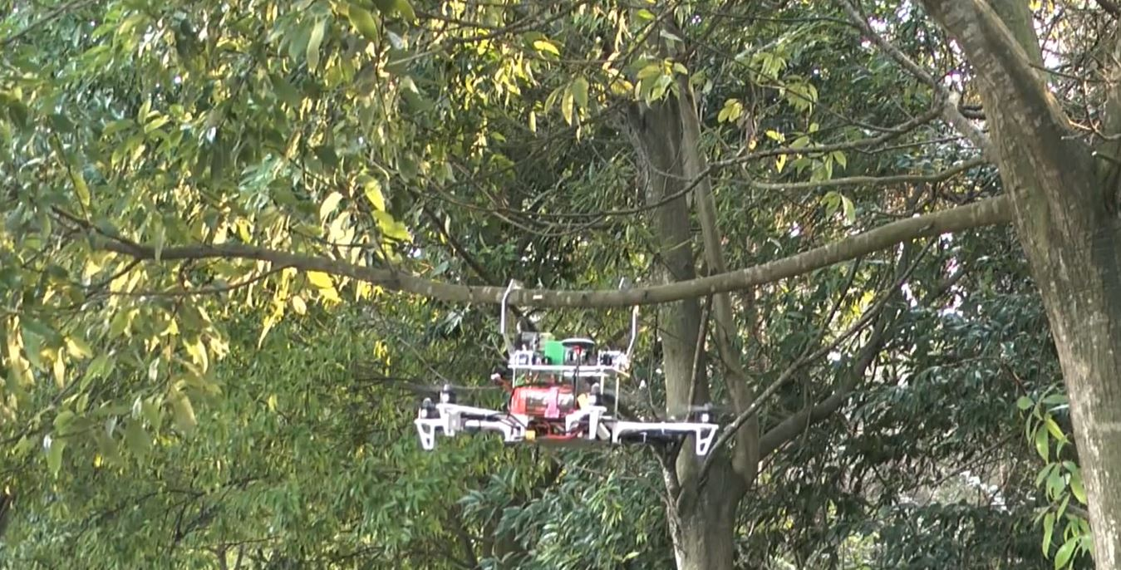
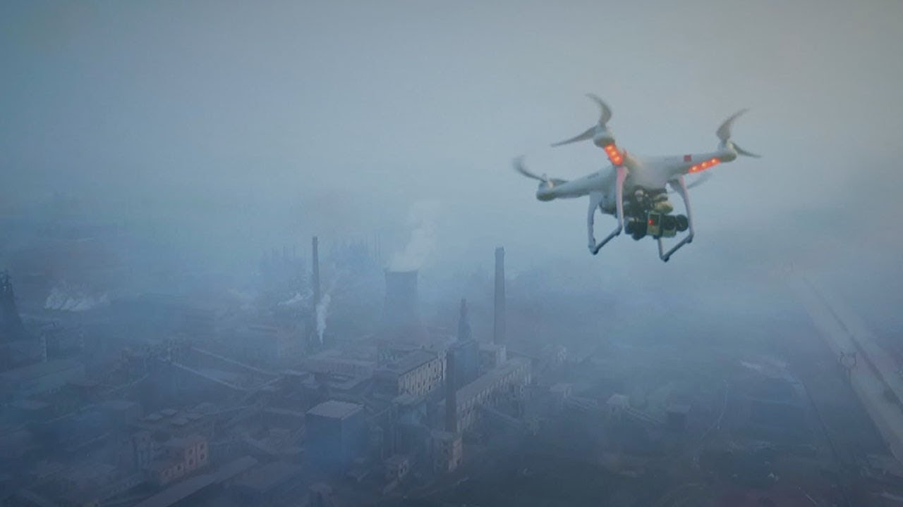


Other Use Cases of Drones
Branch Pruning
Pollution Monitoring
Patrol & Surveillance
Detect Gas Leakage
Notes:
Examples: Branches pruning / disease detection with gas detection, Lidar / patrol and surveillance / pollution monitoring

Slide 22







Conclusion
APPLICATION
BENEFITS
Notes:
Drones or unmanned aerial vehicle (UAV) plays an important role in revolutionizing the businesses such as forestry, manufacturing & agricultural
Uses and applications of drones in appropriate fields are able to generate several benefits such as reduce costs, time and improved efficiency.

